Slide 1

SecureCoding
SQL Injection Prevention

Slide 2
SQL Injection
When SQL injection is performed, the original intent of the sql statement is changed
A “new” command created by the hacker is run instead
So how can we prevent SQL Injection?
We have to “deal” with the hacker’s input payload

Slide 3
SQL Injection PREVENTIOn
If we are dealing with the input, we can either validate or sanitize the input
Our approach is to “clean” the input by escaping it such that for example the column’s value will remain as the value when the sql statement is run

Slide 4
placeholders
With mysql query() function, it is possible to auto escape the user inputs with placeholders represented by ? when the query is run
All the ? Must be replaced in sequential order with values represented in an array in the same order
Example:
var sql = `SELECT userid,email,username FROM user WHERE userid=? and role=?`;
conn.query(sql, [userid,role], function(err, result){
….
}

Slide 5
placeholders
Assuming a user tries to do SQL injection and supplies a payload like 1’ OR 1=1;-- - for the userid
With placeholders, the query function will escape the input from the user such that the sql query will search for userid with value as “1’ OR 1=1;-- -” which really does not exist
With placeholders, escaping which is a form of sanitization is done on the input before the query is executed on the database server

Slide 6
placeholders
Placeholders may also be provided as a key value pair in an array where the key is the column name and value is the value of the column
Example:
var sql = `SELECT userid,email,username FROM user WHERE ? and ?`;
conn.query(sql, [userid:`${userid}`,role:`${role}`], function(err, result){
….
}

Slide 7
Stored procedures
Developers can create stored procedures to create specific views with restricted access rather than using normal queries
With normal queries, programmers can write queries which select all columns data from a table. We can restrict access to sensitive columns data if we utilize stored procedures.
Stored procedure is like a function/method and works like an interface to specific restricted parts of the database
Can also declare variables in the stored procedure
Can embed multiple SQL statements and even implement if else or looping logic

Slide 8
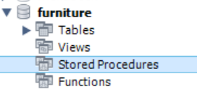
Stored procedures in mysql
Right click on stored procedure and select “Create stored procedure”

Slide 9
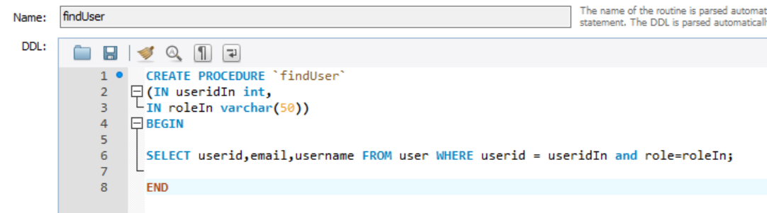
Stored procedures in mysql
Name of Stored Procedure
Parameters

Slide 10
Calling Stored procedures in node js
Do note the stored procedure will return an array of results, so for this specific stored procedure, the query rows data extracted is in result[0]
Calling the stored procedure in Node js:
var sql=`call finduser(?,?)`;
conn.query(sql, [userid,role], function(err, result){
});

Slide 11
Best practices
Best Practices – SQL Injection Prevention:
Use placeholders in mysql node library to escape inputs
Use stored procedures
If it is not possible:
Perform input validation and whitelisting with regular expressions
Datatype checks
Escape input

Slide 12
BEST Practices(Database config)
Create accounts with strong passwords for database access
Create accounts with least privileges on the database for the client applications, allowing access to required data for performance of required tasks only
Ensure connections to database from client applicationsis encrypted

